Slide 1
Supply chain management

Slide 2
Agenda
Objective.
Analysis Of All KPIs.
Presentation of All Dashboards.
MY SQL Queries.
Challenges Occurred.

Slide 3
Objective Of SCM Project
The primary objective is to create a dynamic and insightful dashboard that provides real-time insights and a comprehensive overview of supply chain operations. The key objectives of creating such a dashboard include:
Increase Supply Chain Visibility
Enhanced Decision-Making
Cost Management
Strengthen Supplier Relationships
Improve Demand Forecasting etc.

Slide 4
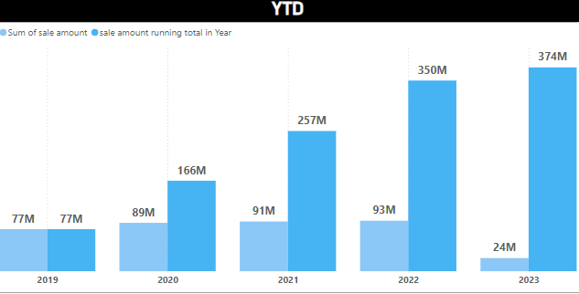
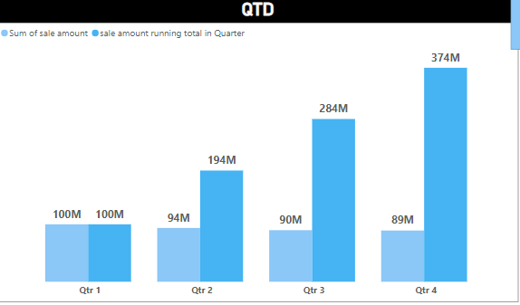
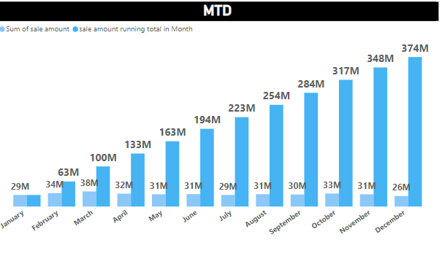
Analysis
Strategies to Improve Sales
KPI 1 –Total Sales
Year To Date:
The total sales for the period show consistent daily fluctuations with amounts mostly between ₹0.22M and ₹0.32M, indicating stable sales performance with minor variances
Quarter To Date And Month To Date:
Sales at the beginning of April show variability, peaking at ₹0.32M on April 2, with subsequent days experiencing a decline, ending at ₹0.21M on April 6. Overall, the trend suggests fluctuating but slightly decreasing sales in the first week of the quarter/month.
CRM Implementation
Sales Training
New Markets
Strategic Partnerships
Influencer Collaborations

Slide 5
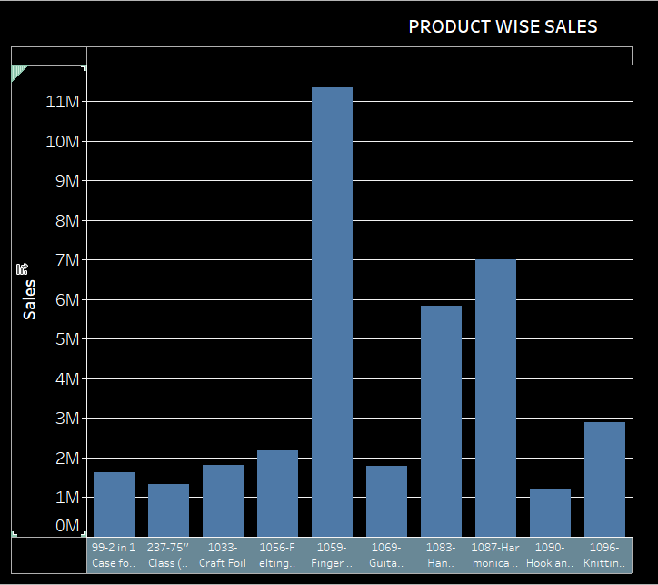
Analysis
KPI 2 – Product Wise Sales
Strategies to Improve Product wise sales
Marketing and Promotions
Discount
Optimize Stock Levels
Supply Chain Efficiency
The product with the highest sales is Finger and hand cymbals at over 11 million, followed by Harmonica holders and Hand percussion stand at around 7 million and 5 million respectively. Other products have significantly lower sales, mostly under 2 million units.

Slide 6
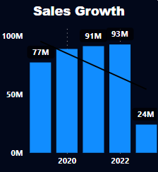
Analysis
KPI 3 – Sales Growth
Strategies to Improve sales growth
Sales trends refer to the patterns and directions in which sales figures move over a specific period.
2020: 77M
2021: 91M
2022: 93M
2023: 24M
Market Research and Competitor Analysis.
Product and Service Improvements.
Marketing and Promotion.
Sales Strategies.
Customer Engagement.
Implementing these strategies can help reverse the downward trend and foster sustainable sales growth.

Slide 7
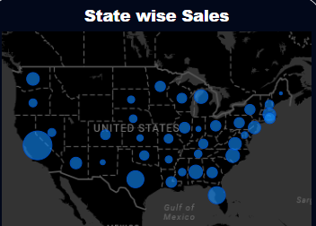
Analysis
KPI 4 – State Wise Sale
Strategies to Improve State wise sales
Overall Sales Performance by State
Total sales for each state: Identify top-performing and underperforming states.
Sales growth or decline year-over-year: Analyze trends in sales performance.
Market share in each state: Assess your company's position relative to competitors.
Best-selling products in each state: Identify regional preferences and opportunities.
Market Research
Marketing Campaigns
Localized Promotions & Discounts
Sales Team Deployment
Partnerships & Collaborations
We can improve our State wise sales adapting this 5 strategy in future we can get good growth in which state have low and poor sales.

Slide 8
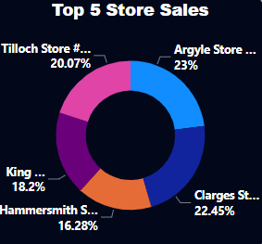
Analysis
Strategies to Improve store sales
KPI 5 – Store Wise Sale
Overall Store Performance
Total Sales: Compare sales figures for each store to identify top performers and underperformers.
Sales Growth: Analyze year-over-year sales growth to identify stores with increasing or declining sales trends.
Sales Per Square Foot: Evaluate store efficiency by comparing sales generated per square foot of retail space.
Store layout & Presentation
Staff Training
Inventory Management
Identifying Customer Trends
Personalized Marketing
We can improve our Store wise sales adapting this 5 strategy in future we can get good growth in which store have low and poor sales.

Slide 9
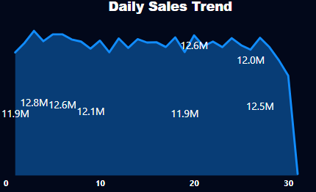
Analysis
KPI 6 –Daily Sales Trend
Strategies to Improve Daily Sales
The "Daily Sales Trend" chart shows the sales figures over a span of 30 days. It represents how sales numbers fluctuate on a daily basis.
Initial Sales: The sales start at 11.9M on the first day.
Fluctuations: There are daily variations, with sales peaking at 12.8M and 12.6M on certain days and dipping to around 11.9M and 12.0M on others.
End of Period: A significant drop is observed at the end of the period, down to 0M on the 30th day
Investigate the Drop
Enhance Stability
Promotional Analysis
Customer Engagement.
By analyzing and understanding the daily sales trends, businesses can make informed decisions to optimize sales strategies, address anomalies, and ensure consistent performance.

Slide 10
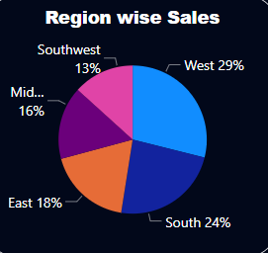
Analysis
KPI 7 –Region wise sales
Strategies to Improve Sales
West (29%): The West region has the highest sales percentage, indicating strong market presence or high demand.
South (24%): The South region is performing well, with the second-highest sales.
East (18%): The East region has moderate sales.
Midwest (16%): Sales in the Midwest are slightly lower than in the East.
Southwest (13%): The Southwest has the lowest sales percentage among the regions.
Competitor Analysis.
Region-specific Campaigns.
Customization.
Expand Distribution Channels.
Feedback and Surveys.
By implementing these strategies, you can improve sales in regions where performance is currently lower and further strengthen sales in already high-performing regions.

Slide 11
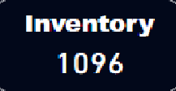
Analysis
KPI 8 – Total Inventory
Strategies to Improve Total Inventory
The current total inventory is 1096 units.
Total inventory represents the sum of all goods or materials a business holds, including raw materials, work-in-progress, and finished goods.
Effective inventory management is crucial for meeting customer demand, minimizing holding costs, and maintaining operational efficiency.
Accurate Demand Forecasting.
Inventory Optimization Tools.
Regular Inventory Audits.
Safety Stock Management.
Inventory Turnover Ratio.
By implementing these strategies, you can improve your total inventory management, ensuring that you have the right products available at the right time while minimizing costs and maximizing efficiency.

Slide 12
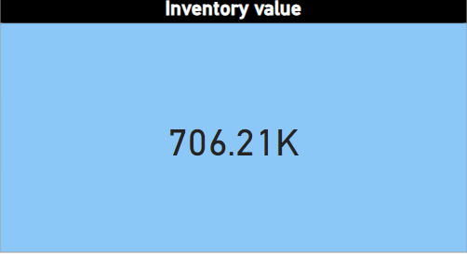
Analysis
KPI 9 –Total Inventory Value
Strategies to Improve Sales
The provided image displays the "Inventory value" with a value of 706.21K. Inventory value represents the total worth of a company's inventory, which includes raw materials, work-in-progress, and finished goods. It is a key metric for managing supply chain efficiency and financial planning. The value helps in assessing the company's ability to meet demand and manage production effectively. A high inventory value can indicate overstocking, while a low value can suggest potential shortages.
Analyze Inventory Turnover
Optimize Stock Levels
Implement Dynamic Pricing
Enhance Product Visibility
Leverage Data Analytics

Slide 13
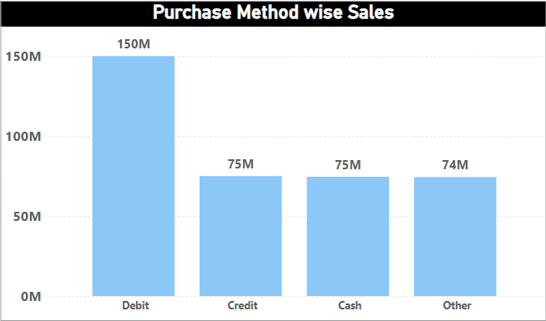
Analysis
KPI 7 –Purchase methode wise sales
Strategies to Improve Sales
The provided image is a bar chart displaying "Purchase Method wise Sales" with data on various payment methods. Debit is the highest with 150M, followed by Credit and Cash both at 75M, and Other at 74M. This chart visually represents the distribution of sales across different purchase methods. It effectively highlights the dominance of Debit payments in sales.
Targeted Promotions and Discounts
Payment Method-Specific Campaigns.
Optimize Checkout Experience.
Analyze Customer Preferences.
Partner with Financial Institutions.

Slide 14
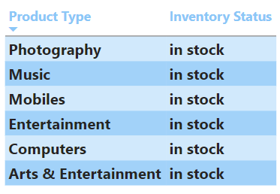
Analysis
Strategies to Improve Sales
KPI 11 –In stoch, Out stock
The table provided lists various product types and their corresponding inventory statuses. Each product type, including Photography, Music, Mobiles, Entertainment, Computers, and Arts & Entertainment, is marked as "in stock." This indicates that all listed product categories currently have available inventory. The uniform status of "in stock" across all categories suggests no immediate supply issues.
Regular Stock Review.
Demand Forecasting.
Supplier Management.
Diversified Inventory
Promotion and Sales.

Slide 15
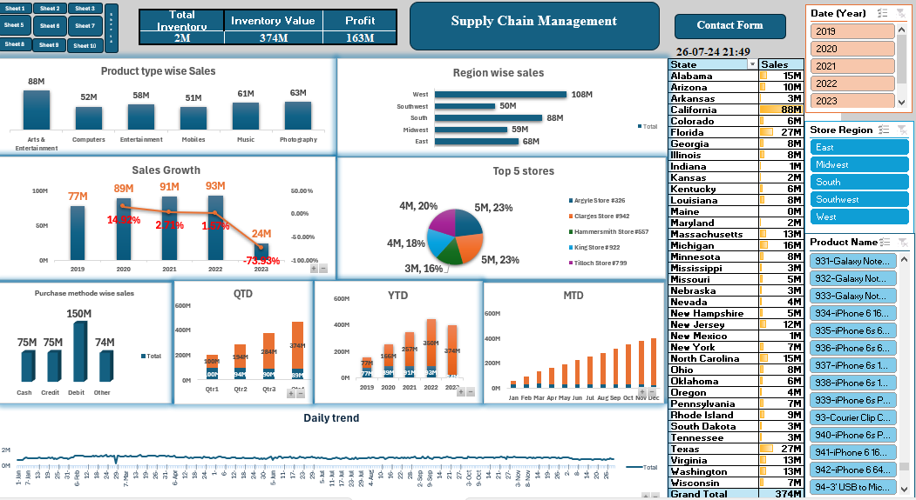
Excel Dashboard For SCM

Slide 16
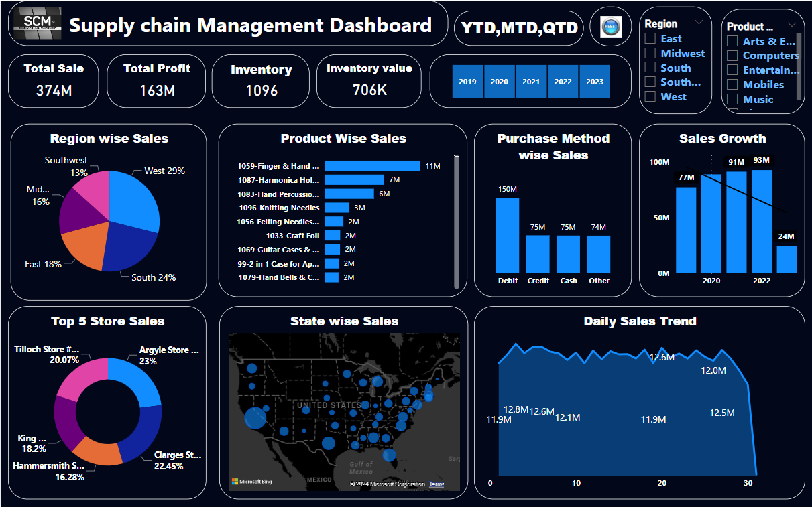
Power BI Dashboard For SCM

Slide 17
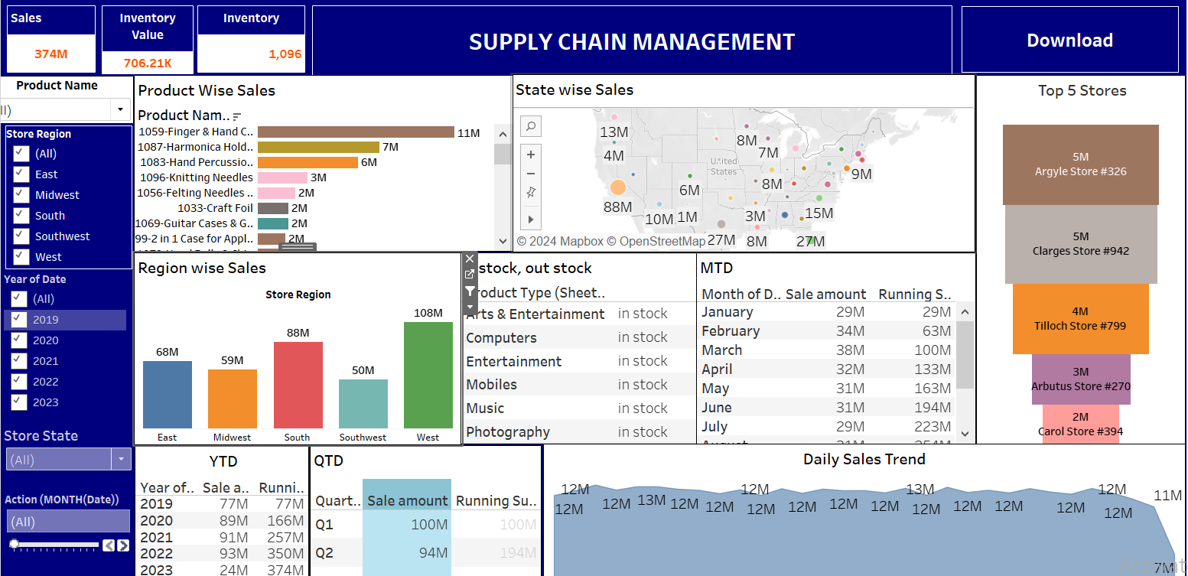
Tableau Dashboard For SCM

Slide 18
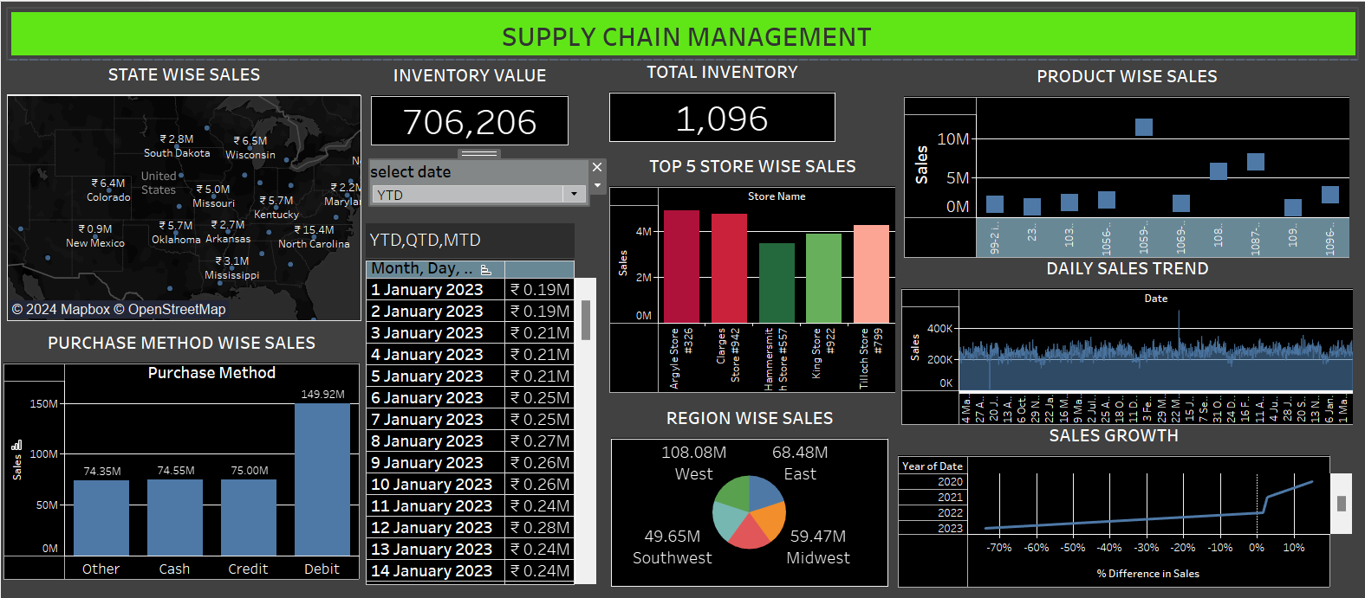
Tableau Dashboard For SCM

Slide 19
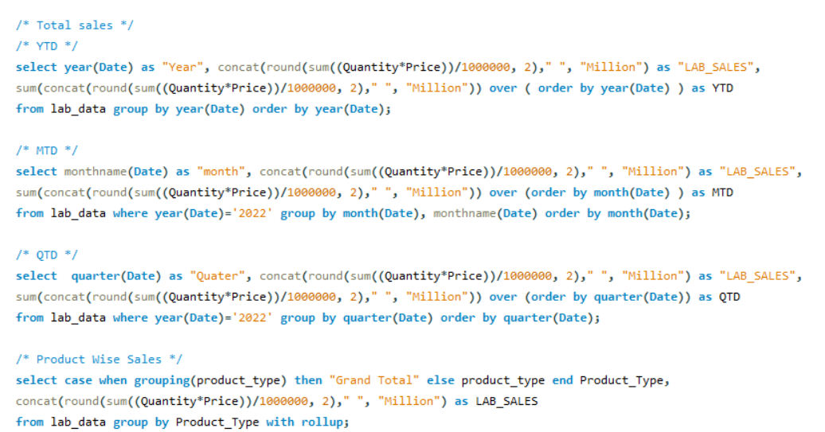
MY SQL Queries For SCM

Slide 20
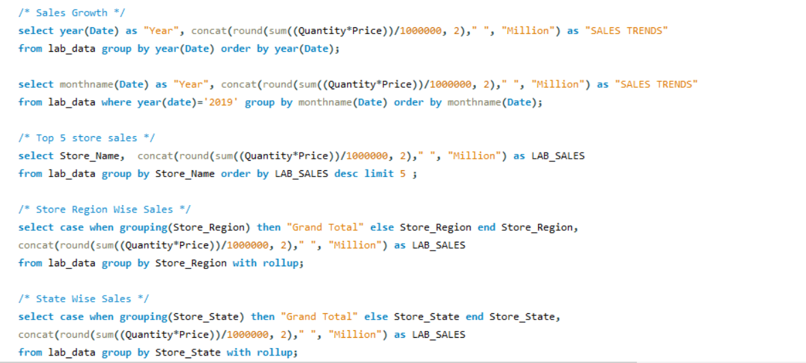

Slide 21
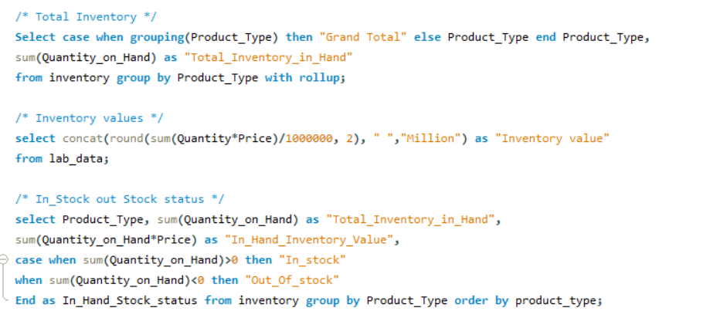

Slide 22
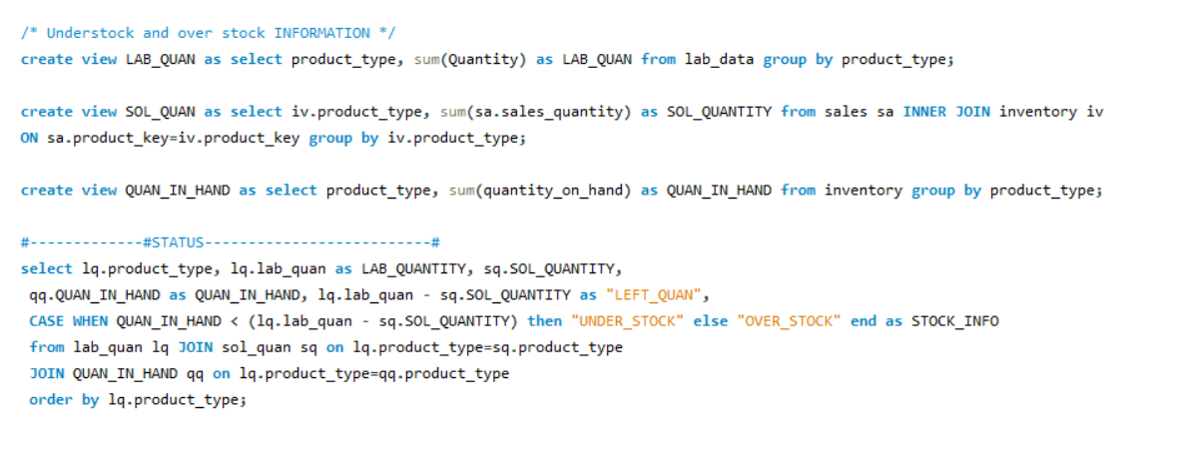
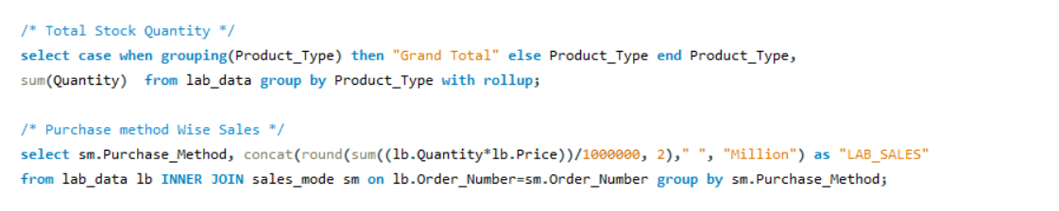

Slide 23
Challenges Occurred
Study of data set is very essential before making any dashboards so, we took time to study and understand such huge data set.
Next we faced a big challenge to import huge data set into workbench as it took literally 2 days to import data through “data import wizard”.
Connecting DB with Power bi and Tableau is again a big task.
For some values its bit difficult to plot in visuals like product wise sales where number of products are high so we switched to product type wise sales.
Designing an interactive dashboard is again a big task as it all depends on individual skills.

